Slide 1
Sem 5 Project Chinmay Shirke 22315A0005

Slide 2
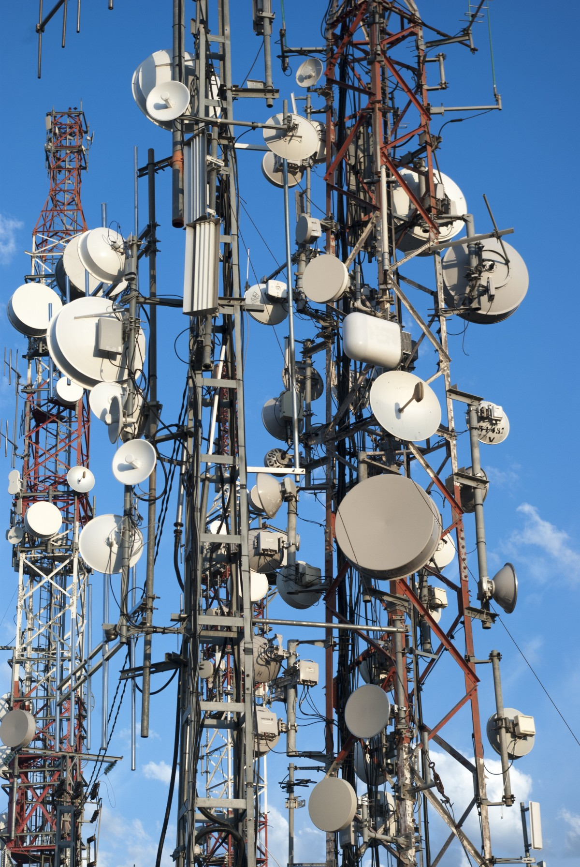
Telecom Industry Churn Prediction.

Slide 3

Domain
Telecommunications
Problem Statement
Predicting customer churn to identify which customers are at risk of leaving the service .

Slide 4
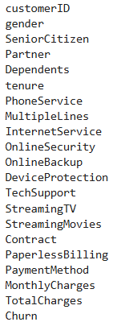

Dataset Description
(Kaggle)
There are total 21 column present in the dataset.
There are all together 7043 Rows present.

Slide 5
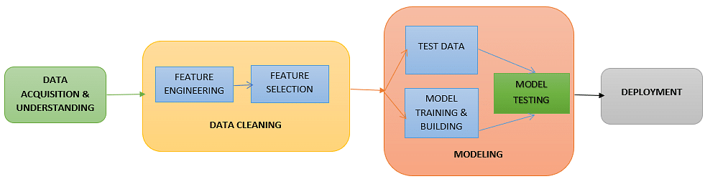
Proposed Solution
Classification Model: logistic Regression, Decition Tree, Random Forest etc
EDA
feature Engineering
Feature Selection
Accuracy Score

Slide 6
Objectives
Accurate Prediction: Develop a model that can predict customer churn with high accuracy.
Identify Key Factors: Understand the main factors influencing customer churn.
Proactive Retention: Enable the telecom company to take proactive measures to retain at-risk customers.
Cost Efficiency: Reduce costs associated with acquiring new customers by focusing on retaining existing ones.

Slide 7
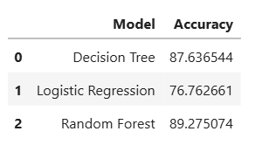
Accuracy

